Slide 1

Content recommendation system based on facial expression recognition using swin transformer model

Slide 2
Group Info-
Kazi Mahathir Rahman (23341066)
(21301349) Md. Samin Rahman
(21301513) Md Farabi Tanim
(24141272) Abdullah All Jilan

Slide 3
TABLE OF CONTENTS
01
02
RESEARCH BRIEFING & LITERATURE REVIEW
Methodology
03
04
DEVELOPMENT
FUTURE WORK

Slide 4
MAIN CONCEPTS
Why recommendation system based on facial expression?
Real-time
Fast
Less computation and preprocessing

Slide 5
Abstract Summary
Utilize Haar Cascade algorithm for real-time face detection in images or video streams, enabling efficient identification of faces
Employ Swin Transformer model for facial expression recognition, capturing global contextual information and subtle nuances in expressions
Utilize datasets such as RAF-DB or CK+ for training the Swin Transformer model on facial expression recognition tasks.
Integrate Haar Cascade algorithm for real-time face detection in the recommendation system pipeline

Slide 6
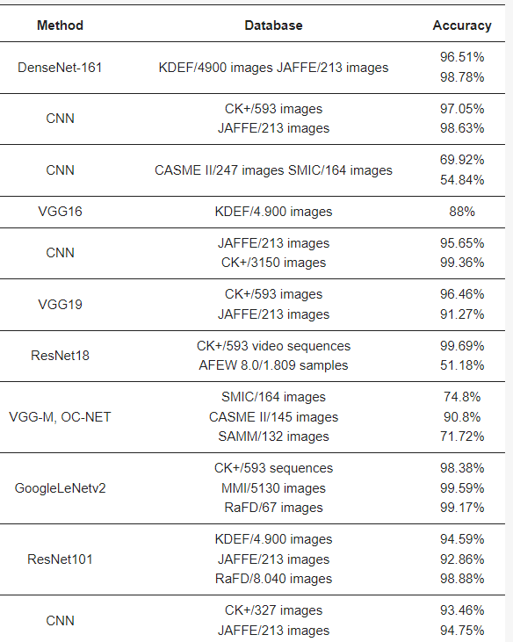
Literature Review
Some existing Techniques for FER-
ML based model
CNN/ RNN based
VGGNet based
ResNet based
Transformer based

Slide 7
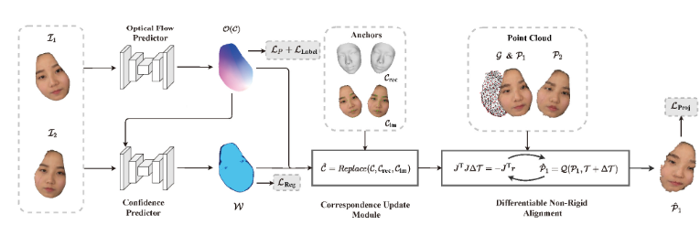
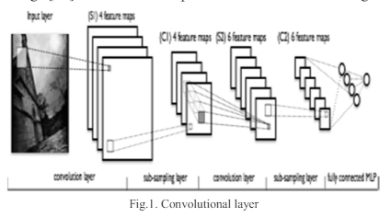
Model
Machine learning based model
Z. Peng, B. Jiang, H. Xu, W. Feng and J. Zhang, "Facial optical flow estimation via neural non-rigid registration", Computational Visual Media, vol. 9, no. 1, pp. 109-122, 2023.
S. Deebika and K.A Indira, "A machine learning based music player by detecting emotions", 2019 Fifth International Conference on Science Technology Engineering and Mathematics (ICONSTEM), vol. 1, pp. 196-200, 2019, March.
R. S. Deshmukh, V. Jagtap and S. Paygude, "Facial emotion recognition system through machine learning approach," 2017 International Conference on Intelligent Computing and Control Systems (ICICCS), Madurai, India, 2017, pp. 272-277, doi: 10.1109/ICCONS.2017.8250725.

Slide 8
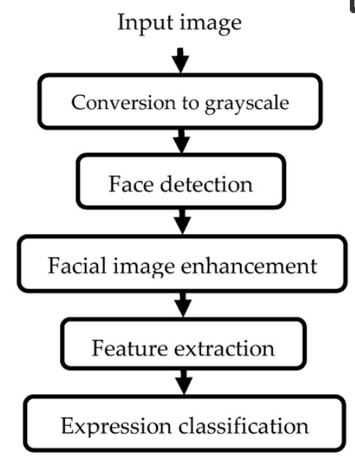
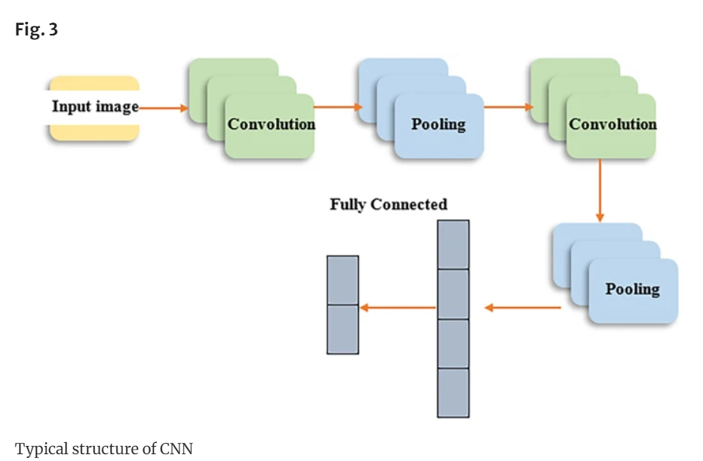
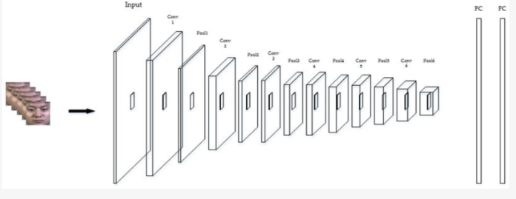
Model
CNN based FER-
Khattak, A., Asghar, M. Z., Ali, M., & Batool, U. (2022). An efficient deep learning technique for facial emotion recognition. Multimedia Tools and Applications, 81(2), 1649-1683.
Li, C. K., Lin, L., Xiong, S. L., Ge, M. Y., Li, X. B., Li, T. P., ... & Zhuang, R. L. (2021). HXMT identification of a non-thermal X-ray burst from SGR J1935+ 2154 and with FRB 200428. Nature Astronomy, 5(4), 378-384.
Bendjillali, R. I., Beladgham, M., Merit, K., & Taleb-Ahmed, A. (2019). Improved facial expression recognition based on DWT feature for deep CNN. Electronics, 8(3), 324.

Slide 9
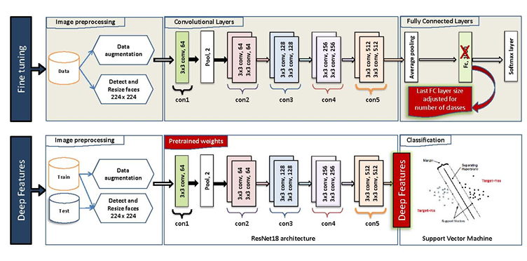
Model
ResNet based model
K. SLIMANI, Y. RUICHEK and R. MESSOUSSI, "Compound Facial Emotional Expression Recognition using CNN Deep Features", Engineering Letters, vol. 30, no. 4, 2022.

Slide 10
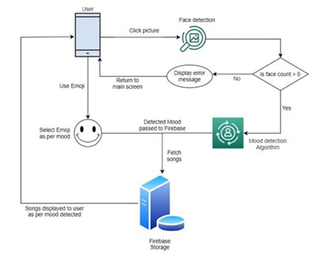
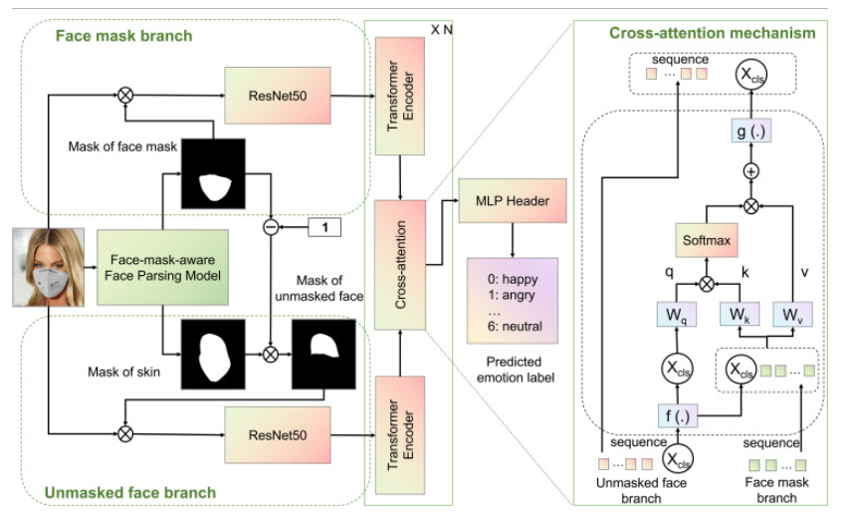
Model
Transformer based model-
A. Mahadik, S. Milgir, J. Patel, V.B. Jagan and V Kavathekar, "Mood based Music Recommendation System", INTERNATIONAL JOURNAL OF ENGINEERING RESEARCH & TECHNOLOGY (IJERT) Volume 10., 2021.
Yang, B., Wu, J., Ikeda, K., Hattori, G., Sugano, M., Iwasawa, Y., & Matsuo, Y. (2022). Face-mask-aware facial expression recognition based on face parsing and vision transformer. Pattern Recognition Letters, 164, 173-182.

Slide 11
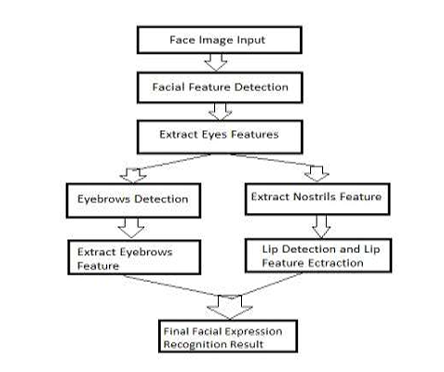
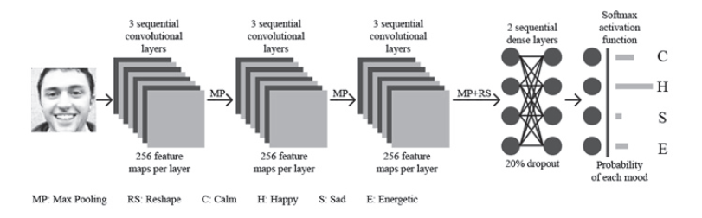
Model
Music Recommendation system-
S. Gilda, H. Zafar, C. Soni and K. Waghurdekar, "Smart music player integrating facial emotion recognition and music mood recommendation," 2017 International Conference on Wireless Communications, Signal Processing and Networking (WiSPNET), Chennai, India, 2017, pp. 154-158, doi: 10.1109/WiSPNET.2017.8299738
Agrahari, P., Tanwar, A. S., Das, B., & Kunekar, P. (2020). Musical Therapy using Facial Expressions. Musical Therapy using Facial Expressions. International Research Journal of Engineering and Technology (IRJET), 7(1).

Slide 12
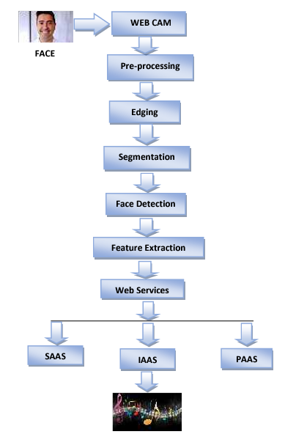
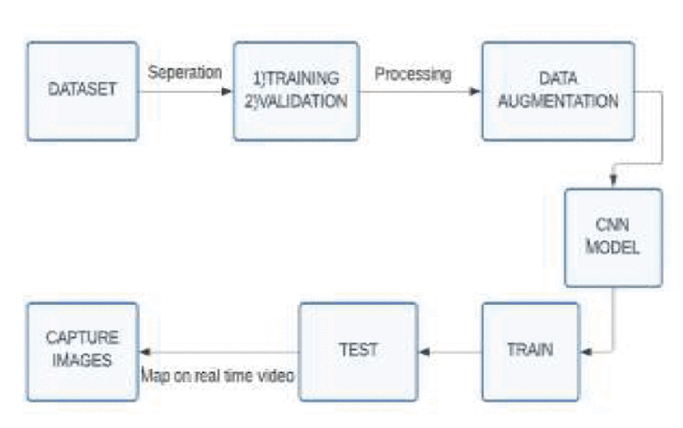
Model
Music Recommendation system-
T. Gorasiya, A. Gore, D. Ingale and M. Trivedi, "Music Recommendation based on Facial Expression using Deep Learning," 2022 7th International Conference on Communication and Electronics Systems (ICCES), Coimbatore, India, 2022, pp. 1159-1165, doi: 10.1109/ICCES54183.2022.9835929
James, H. I., Arnold, J. J. A., Ruban, J. M. M., Tamilarasan, M., & Saranya, R. (2019). Emotion based music recommendation system. Emotion, 6(03).

Slide 13
Some overview paper
Cîrneanu, A.-L.; Popescu, D.; Iordache, D. New Trends in Emotion Recognition Using Image Analysis by Neural Networks, A Systematic Review. Sensors 2023, 23, 7092. https://doi.org/10.3390/s2316709
X. Ben et al., "Video-Based Facial Micro-Expression Analysis: A Survey of Datasets, Features and Algorithms," in IEEE Transactions on Pattern Analysis and Machine Intelligence, vol. 44, no. 9, pp. 5826-5846, 1 Sept. 2022, doi: 10.1109/TPAMI.2021.3067464
S. K. V, R. V. S, R. S, R. Ramalingam, S. M. N and Kiran, "A Comprehensive Overview on Musical Therapy Using Facial Expression Recognition," 2023 International Conference on Distributed Computing and Electrical Circuits and Electronics (ICDCECE), Ballar, India, 2023, pp. 1-5, doi: 10.1109/ICDCECE57866.2023.10151044

Slide 14
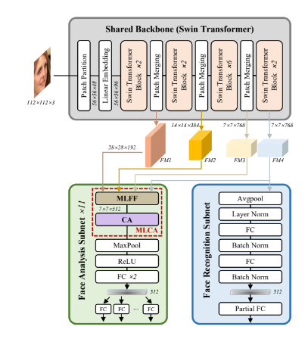
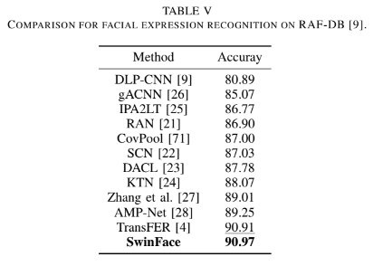
Paper following
L. Qin et al., "SwinFace: A Multi-Task Transformer for Face Recognition, Expression Recognition, Age Estimation and Attribute Estimation," in IEEE Transactions on Circuits and Systems for Video Technology, vol. 34, no. 4, pp. 2223-2234, April 2024, doi: 10.1109/TCSVT.2023.3304724

Slide 15
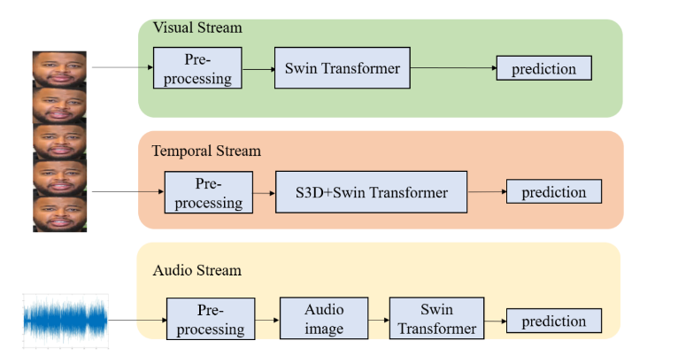
Paper following
Kim, J., Kim, N., & Won, C. S. (2022). Facial Expression Recognition with Swin Transformer. ArXiv. /abs/2203.13472

Slide 16
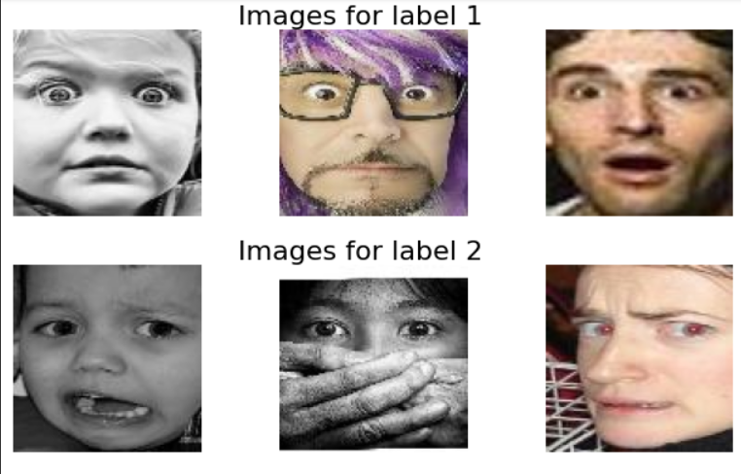
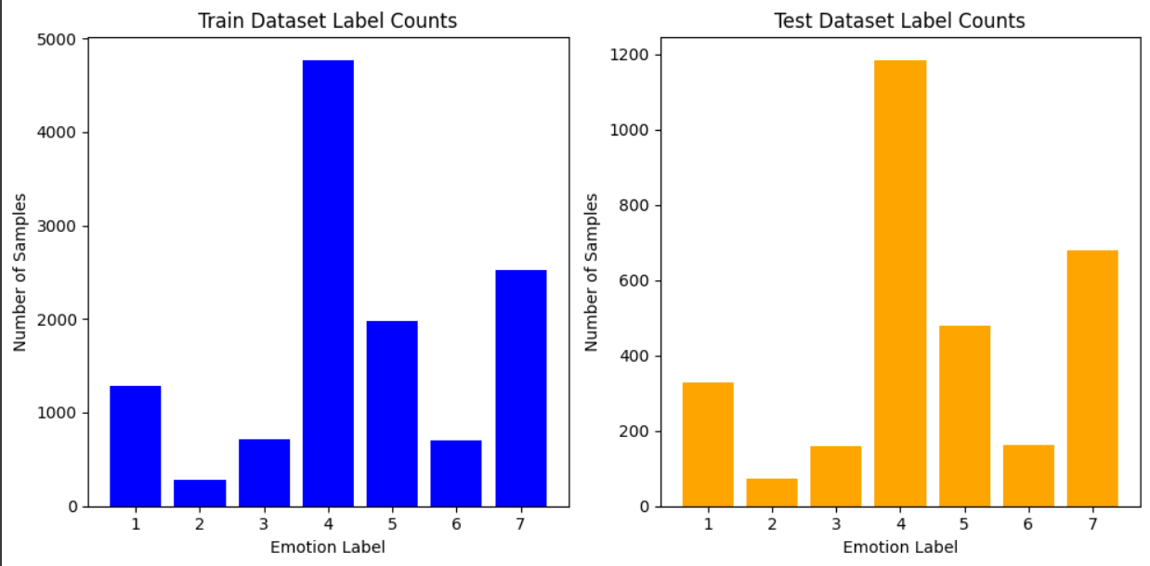
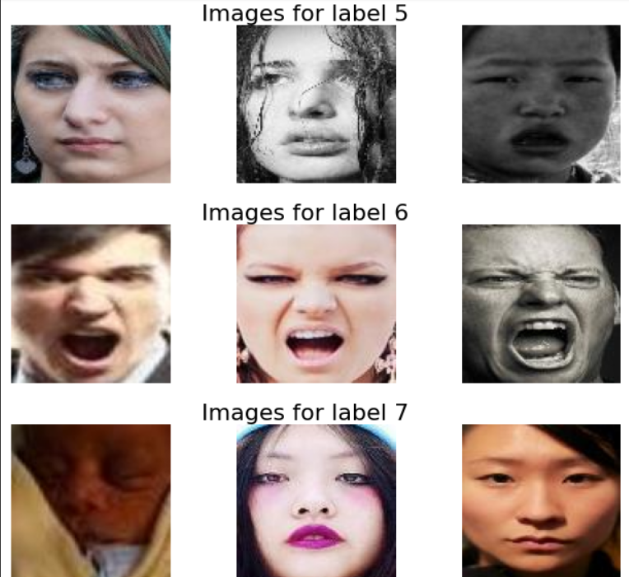
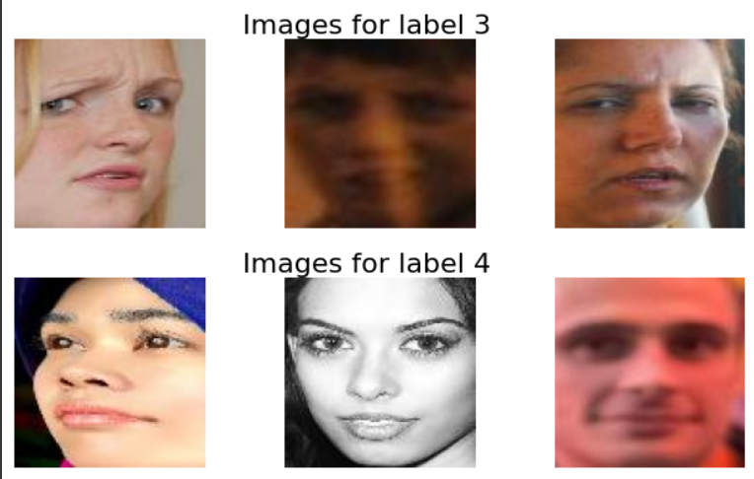
RAF-DB Dataset
12,271 samples from 123 participants
seven different emotional categories, including six basic emotions (happy, sad, angry, surprise, fear, and disgust)
Capture facial expressions, lighting conditions, head poses, and speaking styles
Annotations

Slide 17
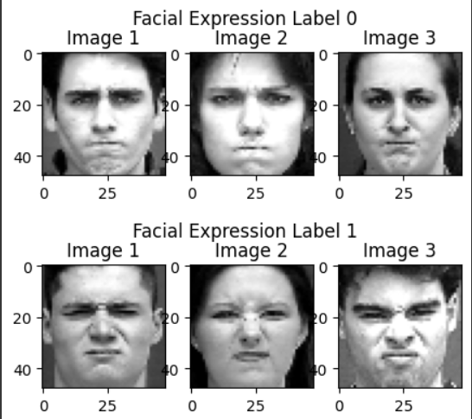
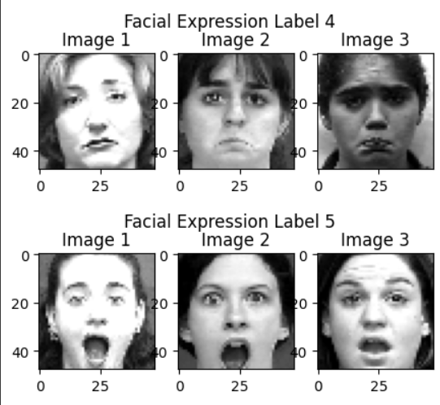
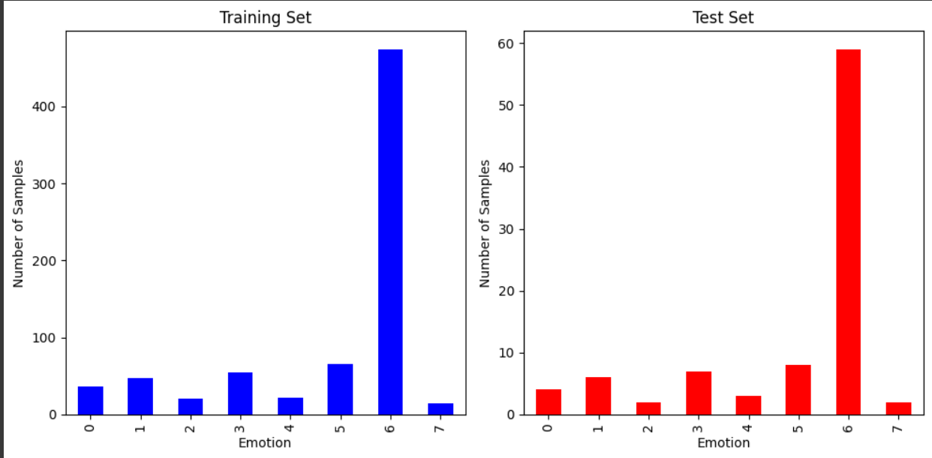
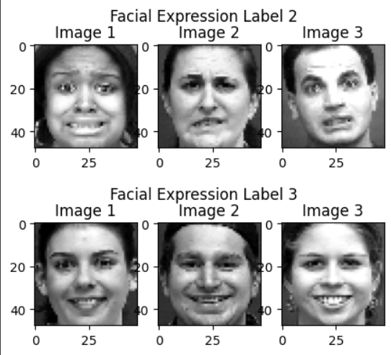
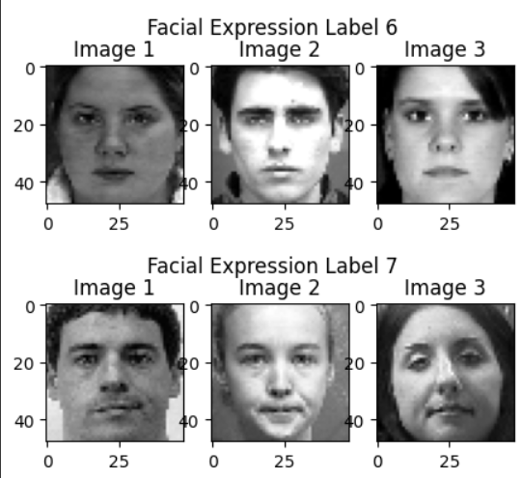
CK+ dataset
Total of 593 image sequences from 123 subjects
Total of 327 facial expressions
seven basic emotions: anger, contempt, disgust, fear, happiness, sadness, and surprise
Grayscale facial images

Slide 18
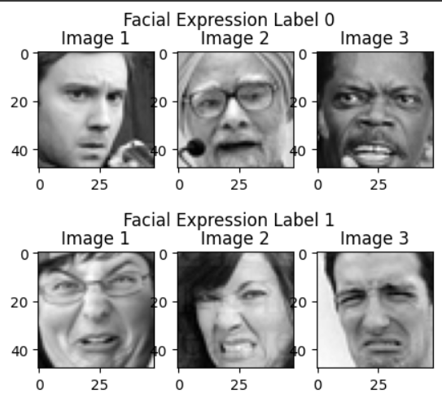
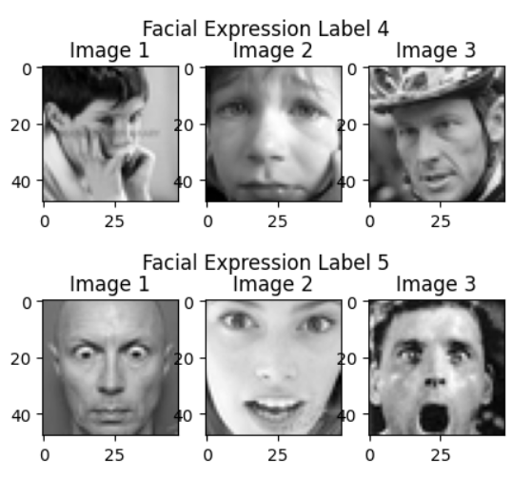
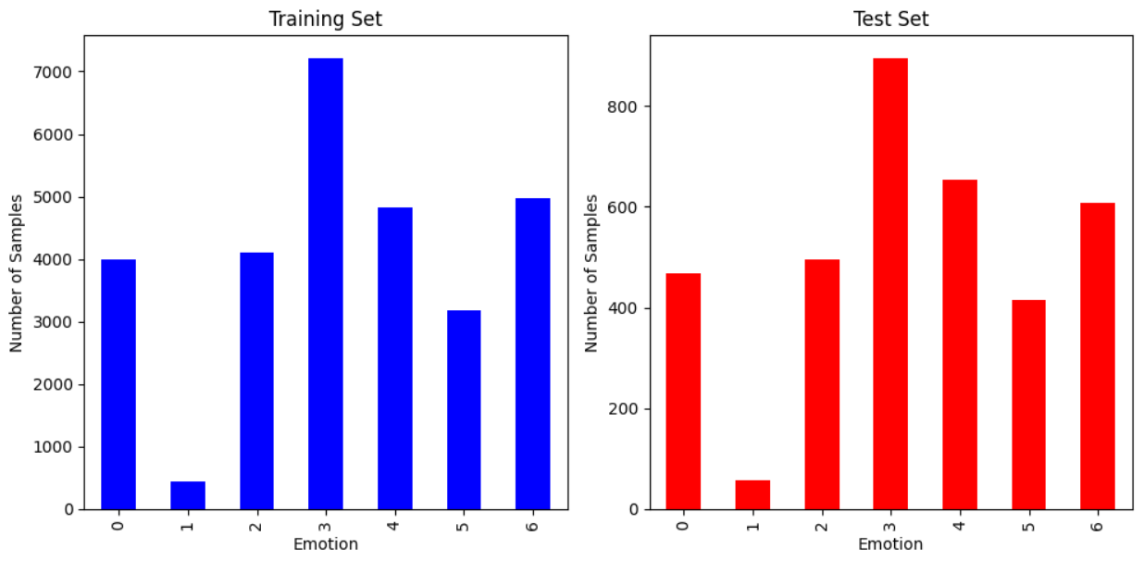
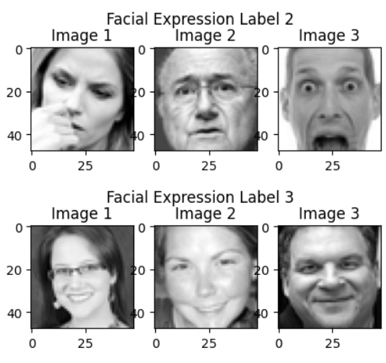
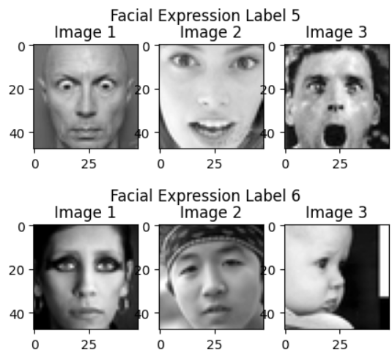
FER2013 Dataset
Total of 35,887 grayscale images of size 48x48 pixels
Training, validation, and test sets with 28,709, 3,589, and 3,589 images, respectively
Seven different emotion categories: anger, disgust, fear, happiness, sadness, surprise, and neutral.
Real-world settings, depicting diverse facial expressions under various conditions

Slide 19
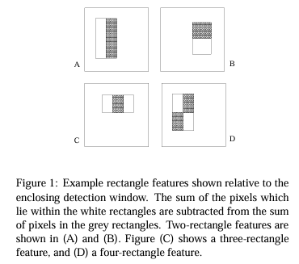
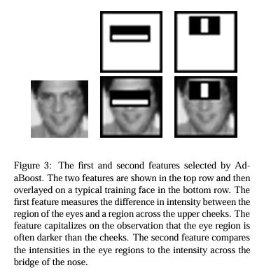
Face detection
Haar cascade
Haar Features
Integral Image
Cascade of Classifiers
Sequential Filtering
Scale and Rotation Invariance

Slide 20
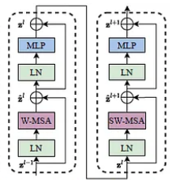
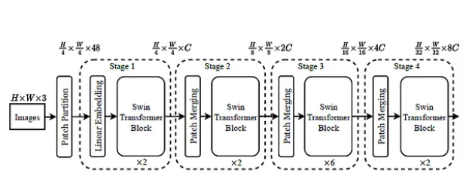
Swin Transformer Model
Input Encoding
Stage-wise Processing
Block Architecture
SWMSA and WMSA Module
MLP Module
Block Connections
Stage Connections
Final Processing

Slide 21
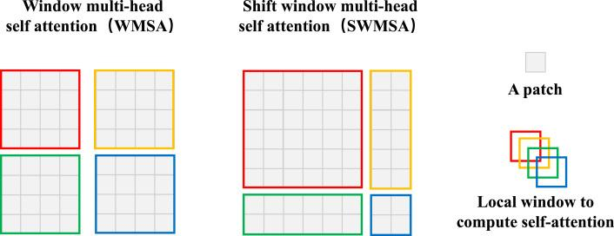
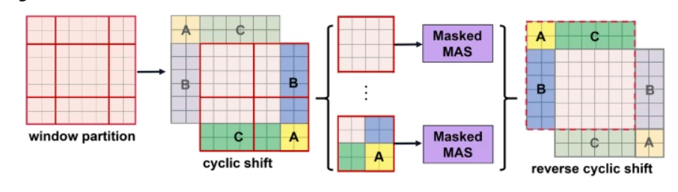
Architecture of WMSA

Slide 22
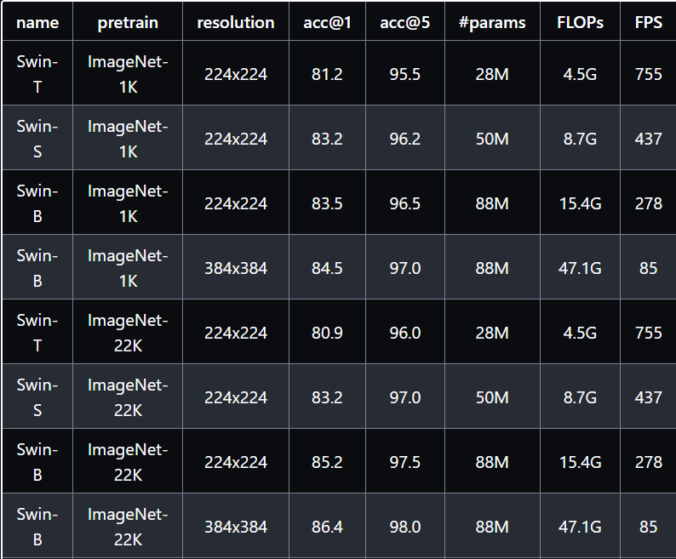
Variation of Swin transformer model
Swin-T
mAP - 95.5
Parameters - 28M
FLOP - 4.5G

Slide 23
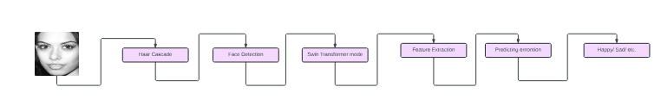
Main Architecture

Slide 24
DEVELOPMENT STAGES
Swin Transformer
Haar cascade
OpenCV
Integration
Swin transformer is used to find expression real time images
Haar cascade was implemented using opencv pretrained model
For using real time detection, we use openCV
Integrating all this, a AI based recommendation system was build

Slide 25
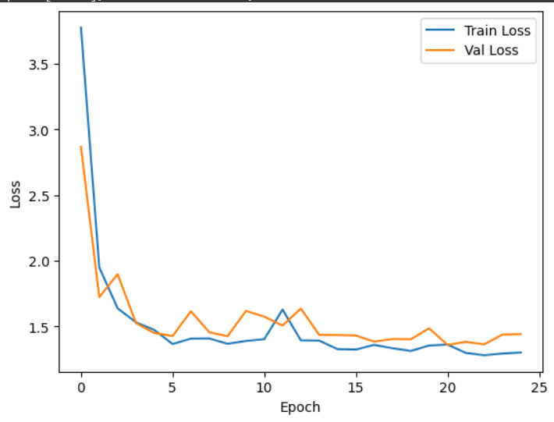
Results
Accuracy
48%
N.B. - The reason behind such low accuracy is limitation of computational re source.

Slide 26
Future Wok

Slide 27
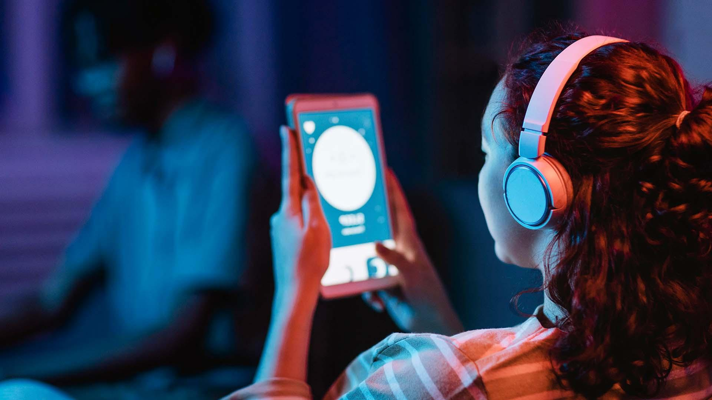
Micro Expression Recognition and analysis

Slide 28
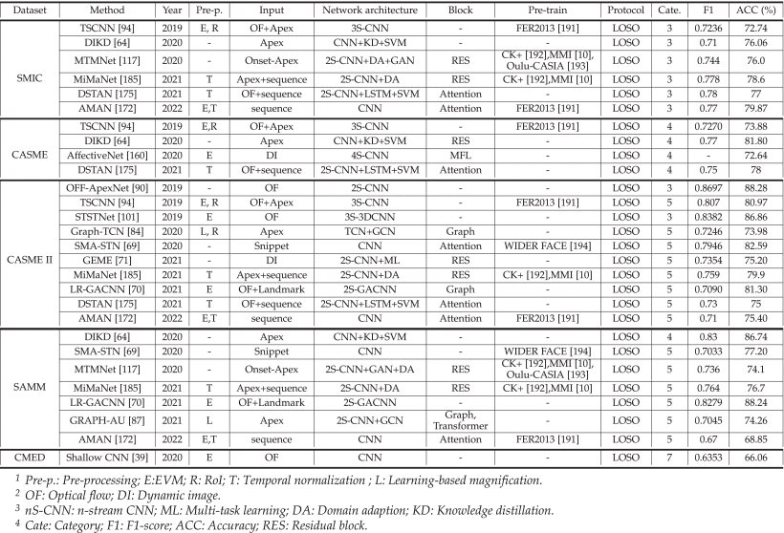
Previous works

Slide 29
MER overview paper
Y. Li, J. Wei, Y. Liu, J. Kauttonen and G. Zhao, "Deep Learning for Micro-Expression Recognition: A Survey," in IEEE Transactions on Affective Computing, vol. 13, no. 4, pp. 2028-2046, 1 Oct.-Dec. 2022, doi: 10.1109/TAFFC.2022.3205170.
X. Ben et al., "Video-Based Facial Micro-Expression Analysis: A Survey of Datasets, Features and Algorithms," in IEEE Transactions on Pattern Analysis and Machine Intelligence, vol. 44, no. 9, pp. 5826-5846, 1 Sept. 2022, doi: 10.1109/TPAMI.2021.3067464.

Slide 30
Datasets for MER
CASME CASME II
CAS(ME)^2
MMVIEW
SMIC-HC
SAMM MMEW

Slide 31
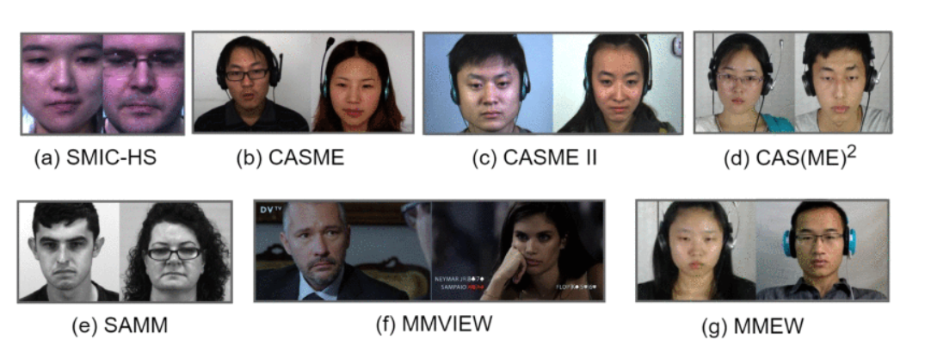
Datasets Overview

Slide 32
PAPER FOLLOWING
Paper name
Paper Overview
Micro Expression Recognition Using Convolution Patch in Vision Transformer
Vision Transformer model for MER
Convolutional patching
Less parameters
Fast result

Slide 33
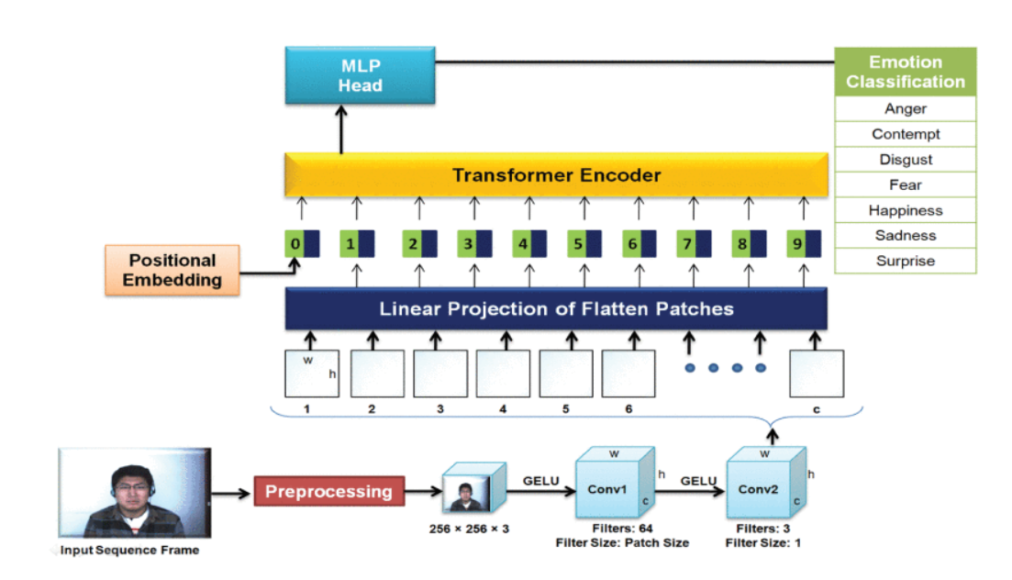
Architecture
Venus

Slide 34
THANKS
Feel free to ask question

